Slide 1

Introduction to R for Data Science
Universitas Airlangga, 14 Agustus 2018
Nanda Prasetya Pamungkas

Slide 2
Overview
Introduction to R
Basic Calculation
Data and Variable
Read and Write Data
Conditional Statement
Looping
Function

Slide 3


Introduction to R
R and Rstudio
R is a language and environment for statistical computing and graphics. Available at https://cran.r-project.org/
RStudio allows the user to run R in a more user friendly environment. It is open source (i.e. free) and available at http://www.rstudio.com/

Slide 4
Introduction to R
Why use R?
Data analysis software: R is s data analysis software. It is used by data scientists for statistical analysis, predictive modeling and visualization.
Statistical analysis environment: R provides a complete environment for statistical analysis. It is easy to implement statistical methods in R. Most of the new research in statistical analysis and modeling is done using R. So, the new techniques are first available only in R.
Open source: R is open source technology, so it is very easy to integrate with other applications.
Community support: R has the community support of leading statisticians, data scientists from different parts of the world and is growing rapidly.

Slide 5
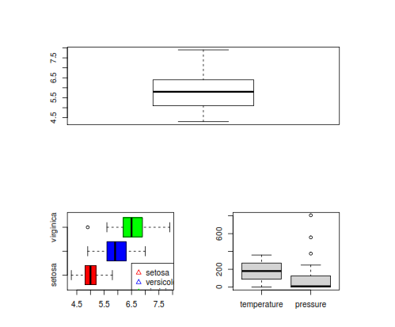
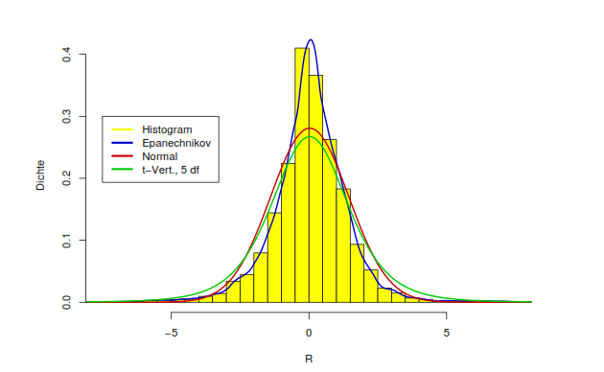
Why use R?

Slide 6
Basic Calculation
Simple Calculation
Function Calculation
> sqrt(2) #squareroot
[1] 1.414214
> sin(pi) #cos,tan
[1] 1.224606e-16
> acos(0) #asin,atan,atan2(y,x) == atan(y/x).
[1] 1.570796
> cosh(0) #sinh,tanh
[1] 1
> exp(2) #log
[1] 7.389056
> 1+2
[1] 3
> 1-2
[1] -1
> 1*2
[1] 2
> 1/2
[1] 0.5
> 1^2 # power
[1] 1
> 5 %/% 2 # integerdivision
[1] 2
> 5 %% 2 # modulodivision
[1] 1

Slide 7
Basic Calculation
Mathematical Function
Function | Meaning
log(x) | log to base e of x
exp(x) | antilog of x (=2.7818x)
log(x,n) | log to base n of x
log10(x) | log to base 10 of x
sqrt(x) | square root of x
factorial(x) | x!
choose(n,x) | binomial coefficients n!/(x! (n – x)!)
gamma(x) | Γ.x.(x – 1)! for integer x
lgamma(x) | natural log of gamma(x)
floor(x) | greatest integer < x

Slide 8
Basic Calculation
Mathematical Function
Function | Meaning
ceiling(x) | smallest integer > x
trunc(x) | closest integer to x between x and 0: trunc(1.5) =1, trunc(-1.5) = -1
trunc | is like floor for positive values and like
ceiling | for negative values
round(x, digits=0) | round the value of x to an integer
signif(x, digits=6) | give x to six digits in scientific notation
runif(n) | generates n random numbers between 0 and 1 from a uniform distribution
cos(x) | cosine of x in radians
sin(x) | sine of x in radians
tan(x) | tangent of x in radians
acos(x), asin(x), atan(x) | inverse trigonometric transformations of real or complex numbers.
acosh(x), asinh(x), atanh(x) | inverse hyperbolic trigonometric transformations on real or complex numbers
abs(x) | the absolute value of x, ignoring the minus sign if there is one

Slide 9
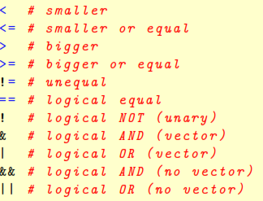
Basic Calculation
Logical Sign

Slide 10
Data dan Variable
Main Structures
Vector array 1 dimensi dengan ukuran m (1 tipe data) Matrix array 2 dimensi dengan ukuran m × n (1 tipe data) Dataframe seperti matrix, namun bisa menampung lebih dari 1 tipe data
Class
character vector of strings
numeric vector of real numbers
integer vector of signed integer
logical vector of boolean (TRUE or FALSE)
complex vector of complex numbers
list vector of R objects
factor sets of labelled observations, pre-defined set of labels
NA not available, missing value

Slide 11
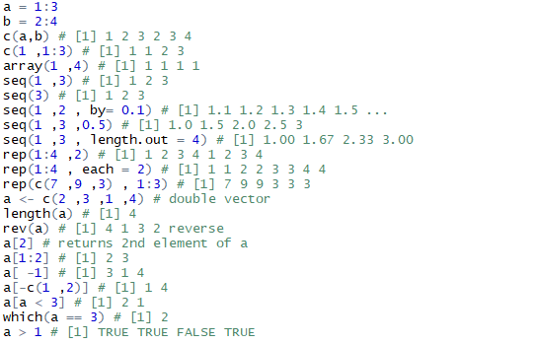

Data dan Variable
Vector

Slide 12
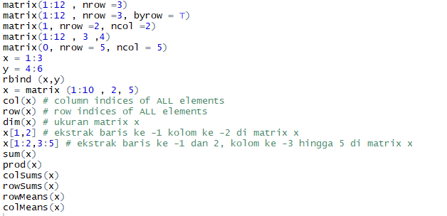
Data dan Variable
Matrix

Slide 13
Data dan Variable
Matrix
x1 = c(2,5)
x2 = c(4,7)
x=cbind (x1,x2)
t(x) #matrix transpose
solve(x) #inverse matrix
[,1] [,2]
x1 -1.1666667 0.6666667
x2 0.8333333 -0.3333333
det(x) #determinant matrix
[1] -6
diag(x) #diagonal matrix
[1] 2 7
y1 = c(3,6)
y2 = c(1,4)
y=cbind (y1,y2)
x*y
x1 x2
[1,] 6 4
[2,] 30 28
x%*%y
y1 y2
[1,] 30 18
[2,] 57 33

Slide 14
Data dan Variable
Dataframe
Age <- c(10 ,20 ,15 ,43 ,76 ,41 ,25 ,46)
Sex <- factor (c("m","f","m","f","m","f","m","f"))
Sibblings <- c(2 ,5 ,8 ,3 ,6 ,1 ,5 ,6)
myframe <- data.frame(Age, Sex, Sibblings)
myframe
Age Sex Sibblings
1 10 m 2
2 20 f 5
3 15 m 8
4 43 f 3
5 76 m 6
6 41 f 1
7 25 m 5
8 46 f 6

Slide 15
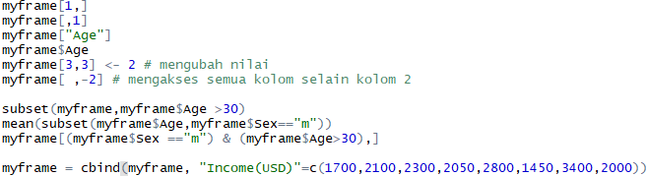

Data dan Variable
Dataframe

Slide 16
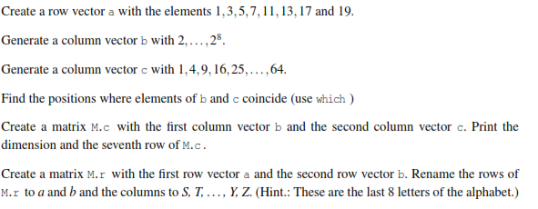
Latihan

